Slide 1

Topic 6
Strings and Conditions

Slide 2
What is a String?

Slide 3
String
A String is a group of characters. Lets look at the following example:
public static void main(String[] args) {
String game = "Super Mario World";
}

Slide 4

public static void main(String[] args) {
String game = "Super Mario World";
}
DATA
S
u
p
e
r
M
a
r
i
o
W
o
r
l
d
\0
INDEX
0
1
2
3
4
5
6
7
8
9
10
11
12
13
14
15
16
17
Keep in mind two things:
We start counting positions at 0. Character ‘S’ in stored at index 0.
To indicate that a String ends, Java stores a NULL character (\0) at the end of the character chain.

Slide 5
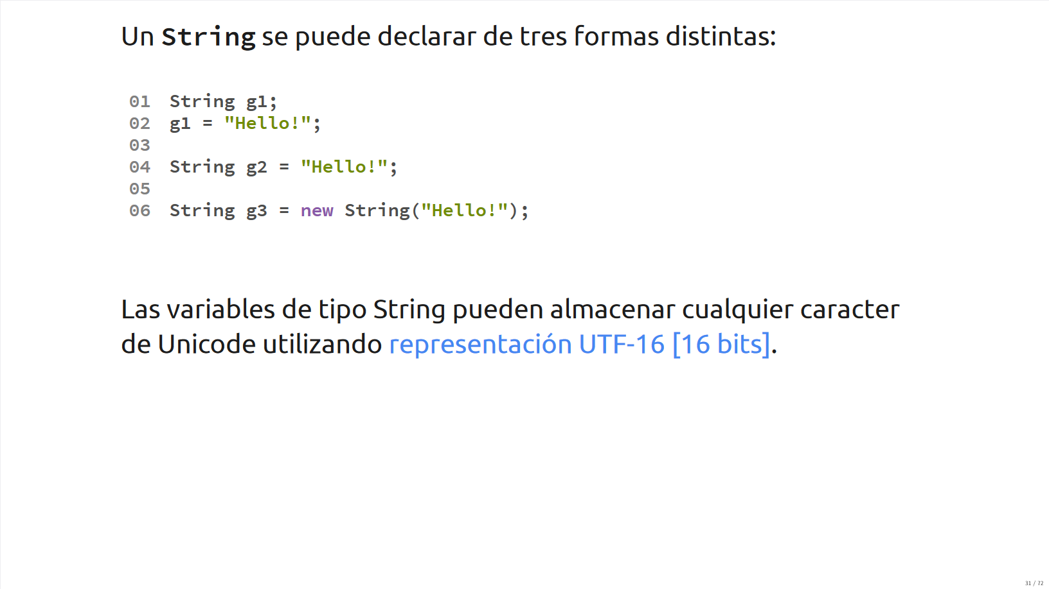

Slide 6
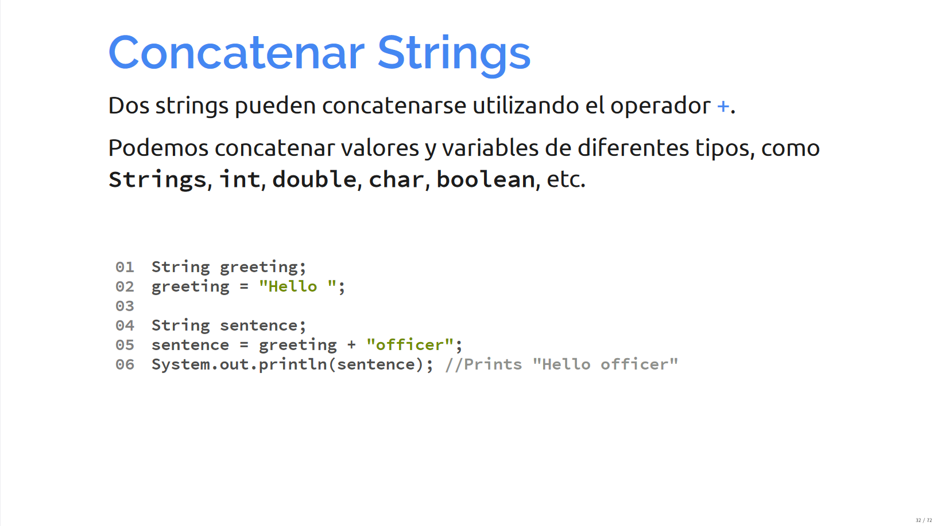
String concatenation
Two strings can be concatenated using the addition operator (+).
We can concatenate different data types together in this way (Strings, ints, doubles, chars).

Slide 7
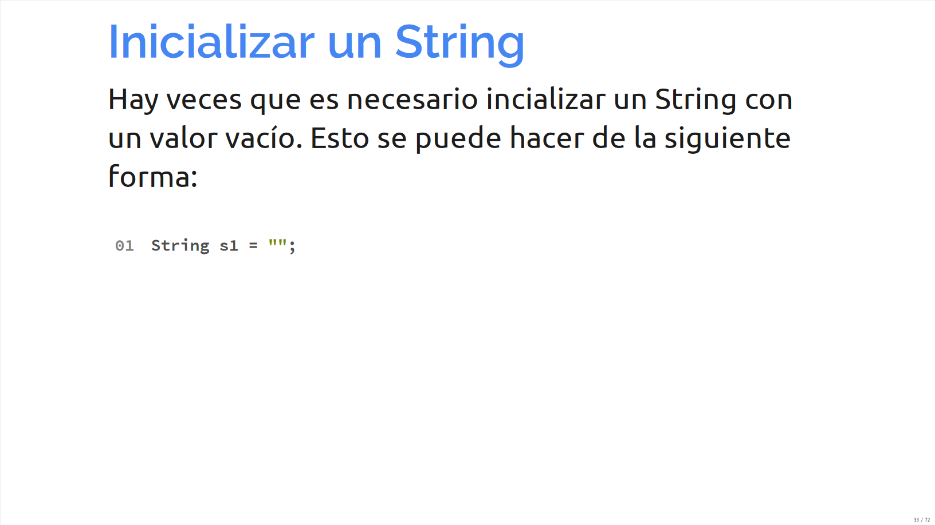
Iniatilize String
We can initialize an empty String using the following statement.

Slide 8
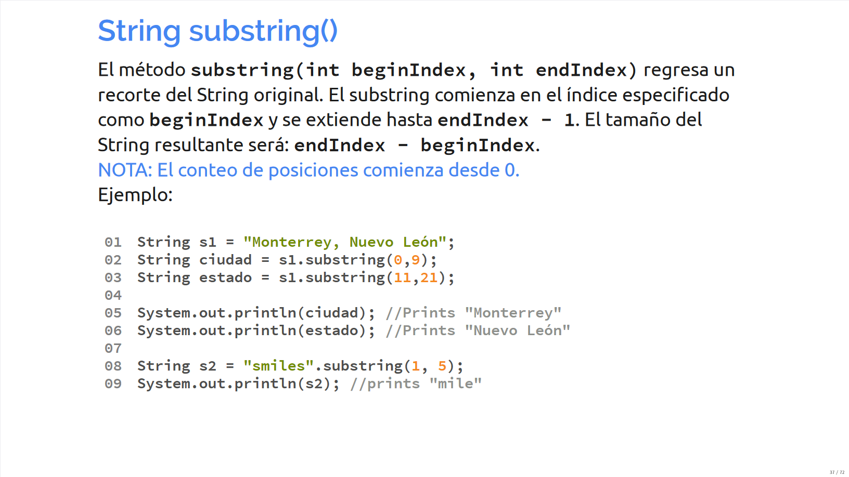
substring() method
The substring(int beginIndex, int endIndex) method returns a smaller set of a given original String.
The substring will begin in the given specified index (beginIndex) and will extend until (endIndex – 1).
The size of the resulting string will be endIndex - beginIndex

Slide 9
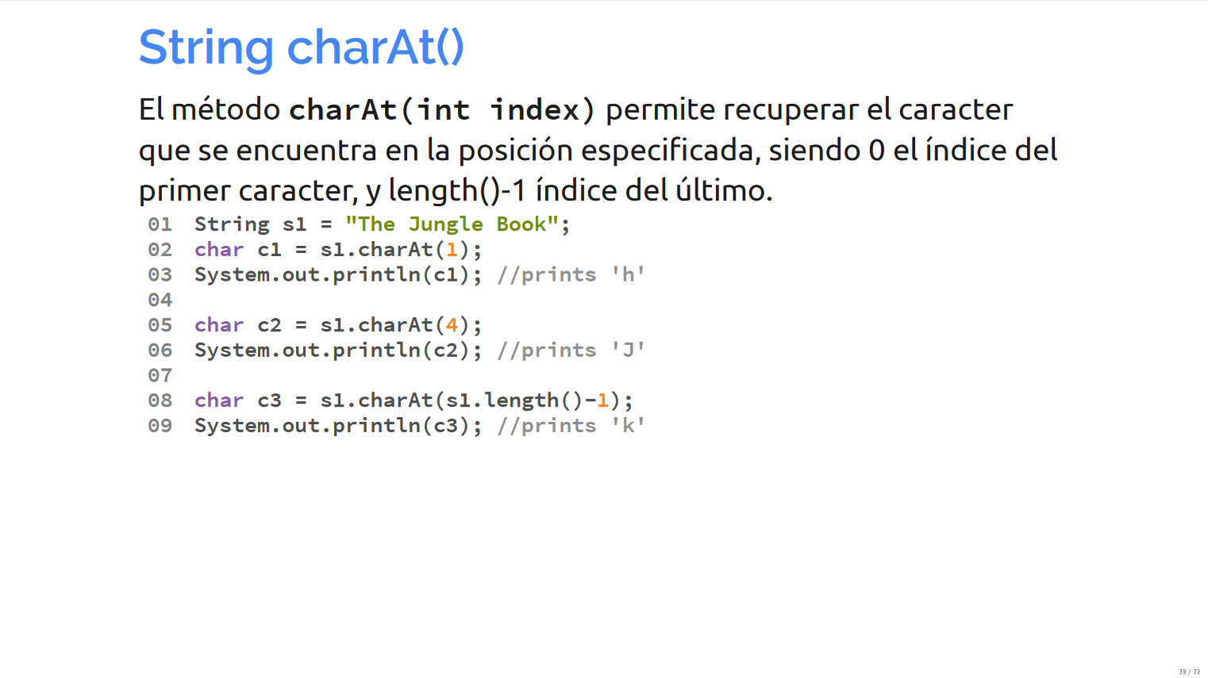
charAt() method
The charAt(int index) method allows you to retrieve the character at the given specified position.

Slide 10
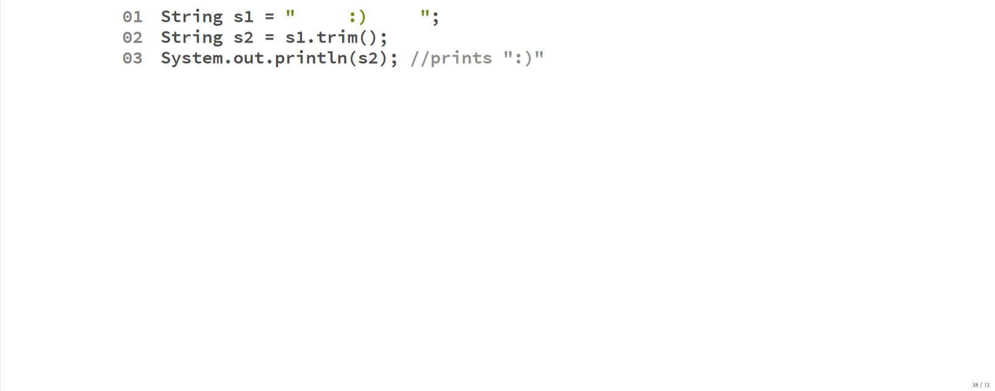
trim() method
The trim() method creates a new string without the empty blank spaces at the beginning and the end of the String.

Slide 11
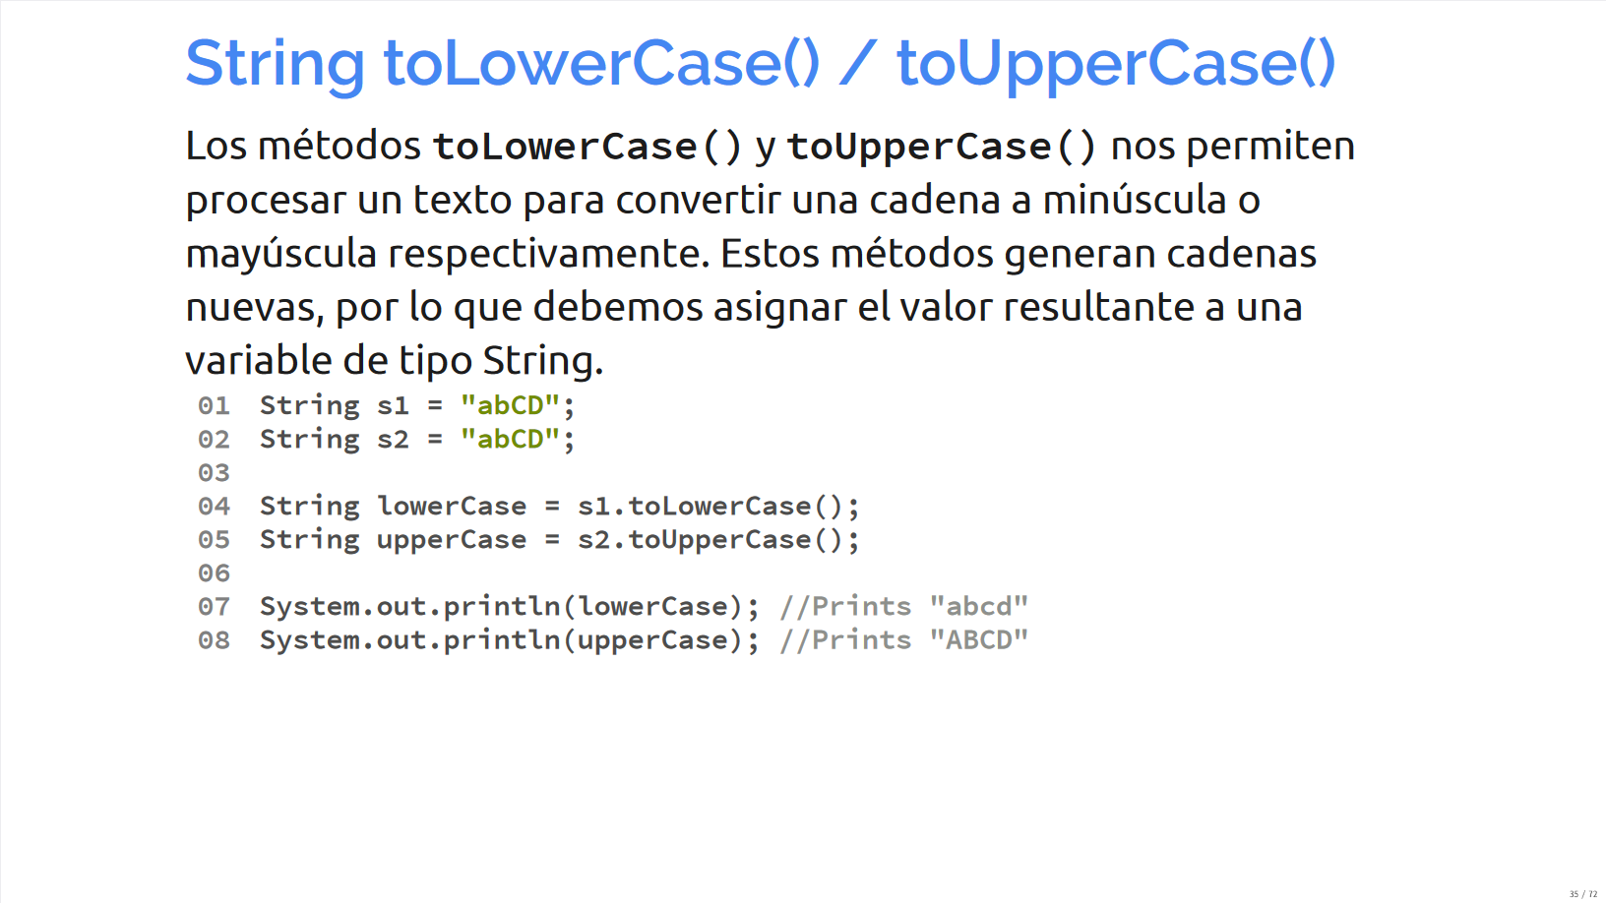
toLowerCase() and toUpperCase() method
Methods toLowerCase() and toUpperCase() allow us to convert a given String into upper or lowercase respectively. This methods create new Strings, so we usually assign their result to a new String variable.

Slide 12
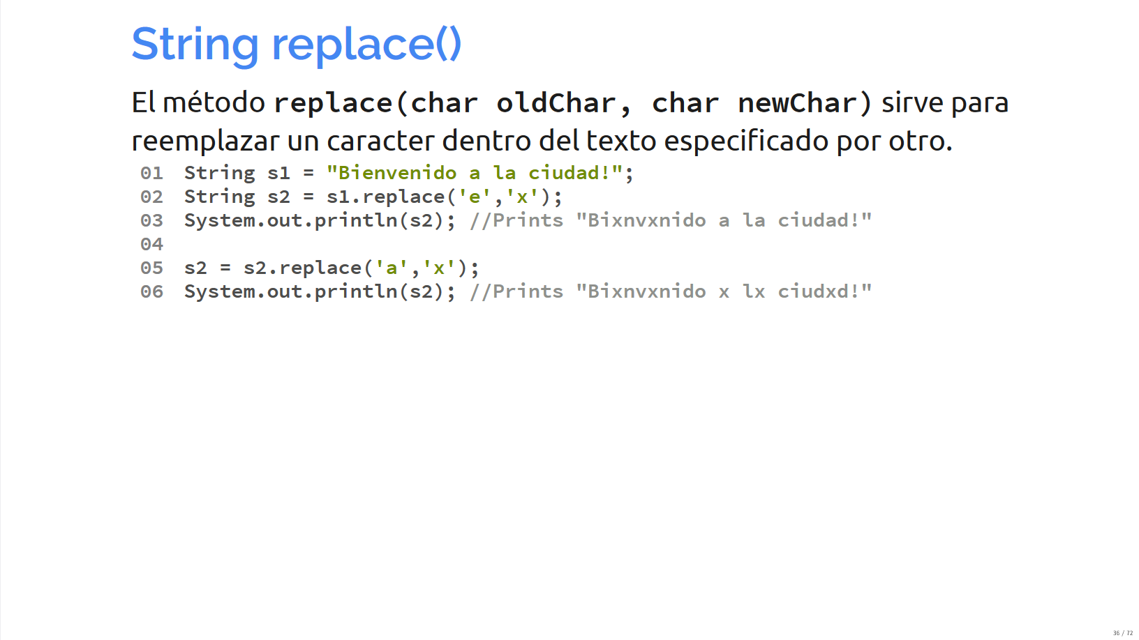
replace() method
The replace() method allows you to replace a character inside of a given text for another.

Slide 13
Conditions

Slide 14
IF
The if statement is a flow control instruction that allows some statements to be executed selectively.
When the boolean expression inside of the if statement evaluates true, then the instructions inside of the block { } will execute.
int numerator = 10;
int denominator = 2;
int result;
if (denominator != 0){
result = numerator / denominator;
}

Slide 15
IF-ELSE
The if block can be paired with an else, which will only be executed when the boolean expression evaluates as false.
int numerator = 5;
int denominator = 0;
int result;
if (denominator != 0){
result = numerator / denominator;
} else {
System.out.println("Error, you cannot divide by zero");
}

Slide 16
Boolean Expression
Inside of an if statement, we put a boolean expression. This can be a simple boolean expression:
if (minutes > 60){
hour++;
}
if (letter == 'c') {
System.out.println("You selected option c");
}
Or complex boolean expressions, which are made up of more than one condition
if ((hour >= 8) && (hour <= 22)){
System.out.println("The store is open!");
}
if (letter == 'a' || letter == 'e' || letter == 'i' || letter == 'o' || letter == 'u' ){
System.out.println("Letter is a vocal!");
}

Slide 17
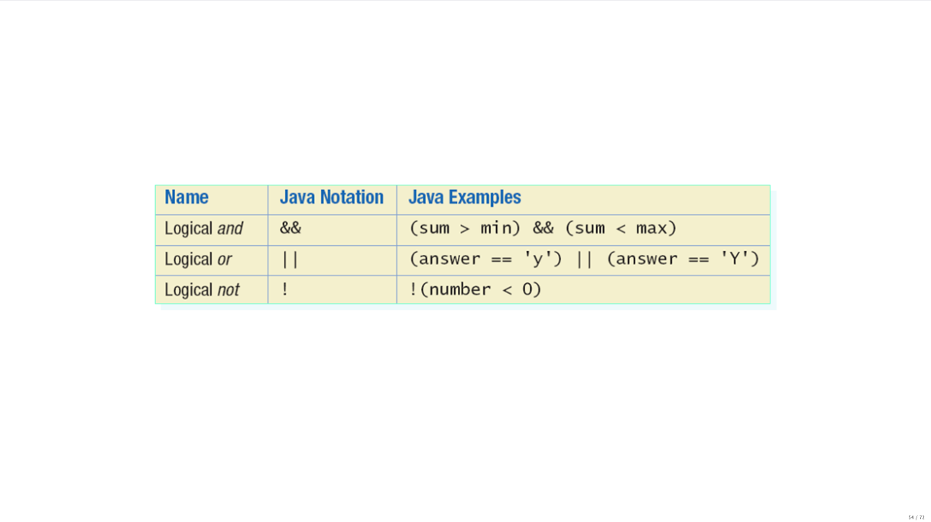

Slide 18
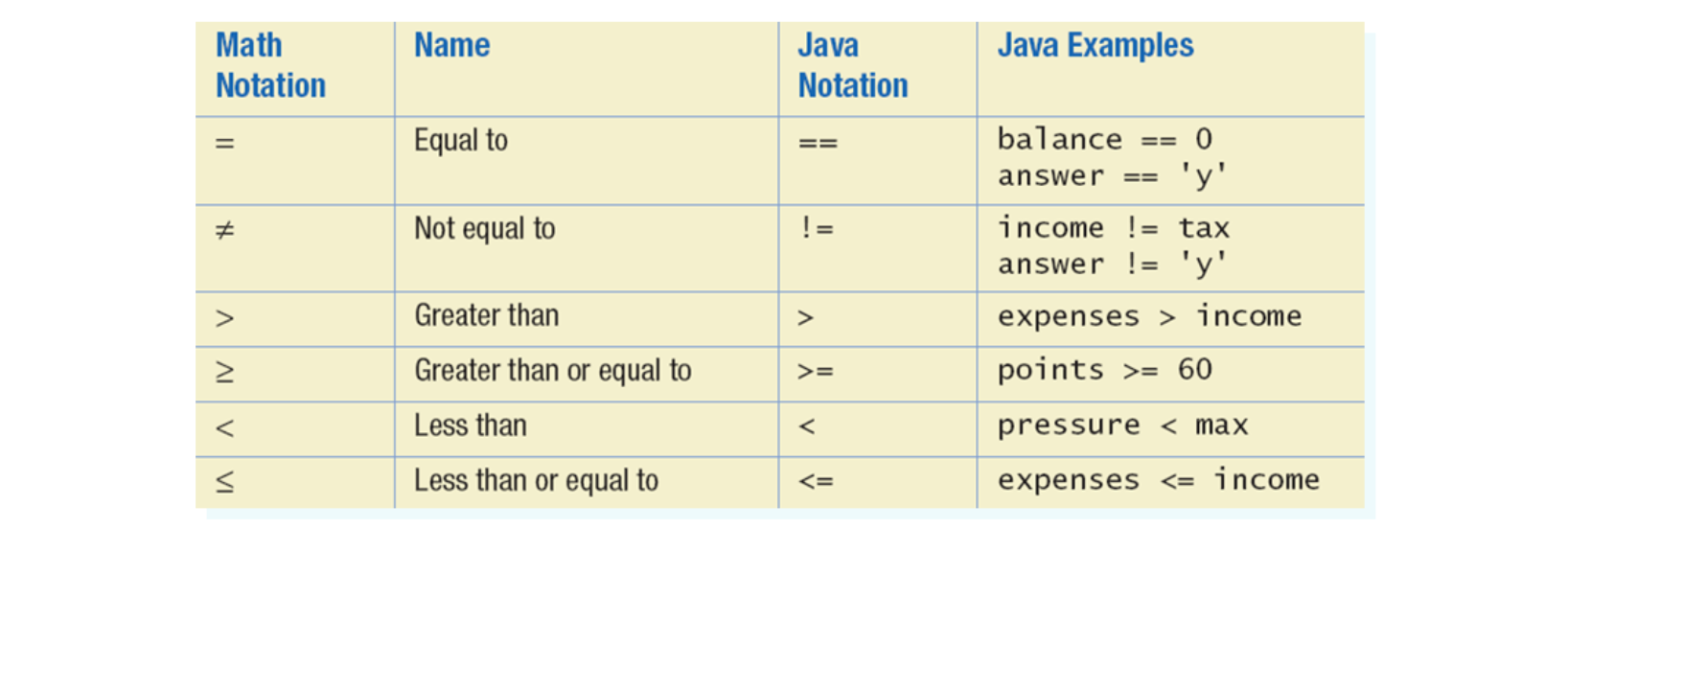

Slide 19
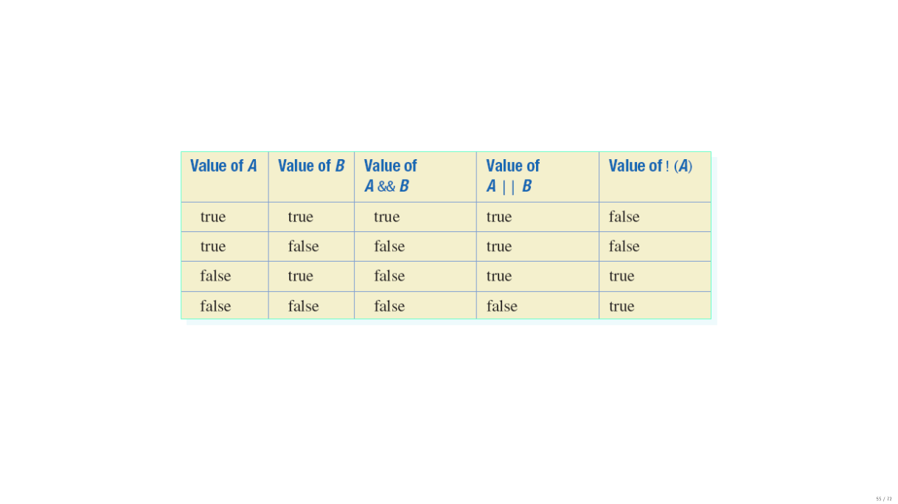

Slide 20
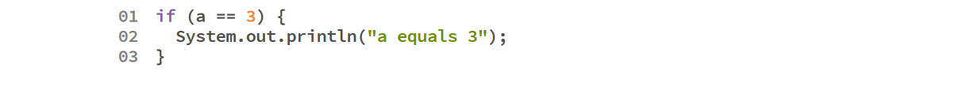
Comparing primitive variables
To compare two primitive variables, we can use the equality operator (==).
For example:

Slide 21
Comparing Strings
Strings, on the other hand, are not primitive variables and can only be compared using the equals() method.
For example:
String s1 = "hello";
String s2 = "goodbye";
if (s1.equals(s2)){
System.out.println("The strings are equal");
} else{
System.out.println("The strings are different");
}

Slide 22
Comparing Strings
Imagine the following Strings s1 and s2. Can you think of a way to test if they are equal without considering lower and upper cases?
String s1 = "hello";
String s2 = "HELLO";

Slide 23
Option 1
We can compare two Strings using the equalsIgnoreCase():
String s1 = "hello";
String s2 = "HELLO";
if (s1.equalsIgnoreCase(s2)){
System.out.println("The strings are equal");
} else{
System.out.println("The strings are different");
}

Slide 24
Option 2
Convert both strings to upper case / lower case, then compare them using the equals() method:
String s1 = "hello";
String s2 = "HELLO";
s1 = s1.toLowerCase();
s2 = s2.toLowerCase();
if (s1.equals(s2)){
System.out.println("The strings are equal");
} else{
System.out.println("The strings are different");
}

Slide 25
Excercise!

Slide 26
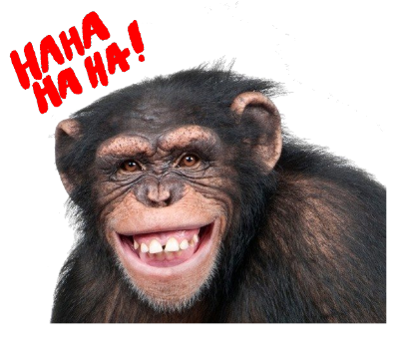
Monkey Trouble
There are two monkeys in a cage. We are in trouble if:
Both monkeys are smiling
None of the monkeys are smiling
Design a Java program to model this interaction

Slide 27
